Slide 1
Speech Recognition
Frapiccini Cecilia
Gilardi Luca
Micheli Giacomo
Saviello Raffaele

Slide 2
Index
Introduction and data presentation
First Analysis and PCA
Conclusion (Future steps)

Slide 3
Introduction
Our dataset is contained in the “emuR” package and it is called “dip”
It contains several samples along with their associated information
actual data (dip$data)
speaker label (dip.spkr)
diphthong label (dip.l)

Slide 4
Our dataset
Two speakers, a male and a female
Three diphthongs (aI, aU, OY) for a total of 186 samples, 93 for each speaker, divided as:
59 times for aI
22 times for aU
12 times for OY

Slide 5
Samples and Observations
Each sample is generated by a variable number of observations taken every 5 ms during the time window needed to record the entire diphthong.
Time windows last on average 145 ms
Each observation is composed of 4 numerical values referring to the four formants

Slide 6
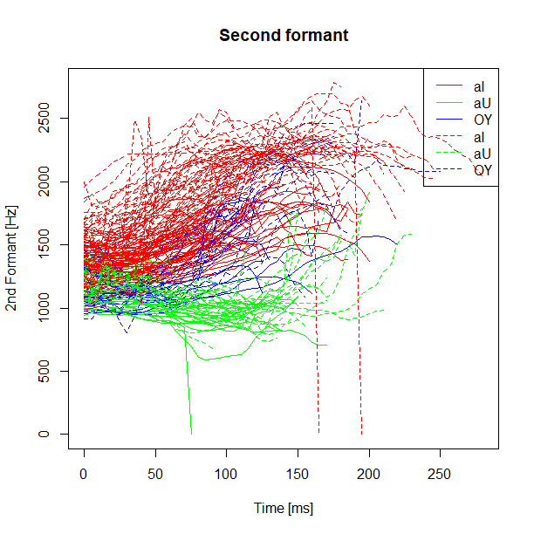
What is a Formant?
In speech science and phonetics, a formant is the spectral shaping that results from an acoustic resonance of the human vocal tract
Notes:
https://en.wikipedia.org/wiki/Formant

Slide 7
Goals
Analyzing separately male and female in order to point out differences and common issues
Join the results above and highlight pattern to recognize a diphthong when pronounced (regardless of speaker’s gender)

Slide 8
Are two speakers enough for our goals?
YES
The differences between different genders are more relevant than differences within the same gender
If we discover some similarities between our two speakers we may generalize them to an entire population
However, analyzing only two speakers allows us to discover relevant patterns at least inside the same gender

Slide 9
Different datasets
Creation of six different datasets with normal time in order to analyze the main patterns on each diphthong for both genders:
Female_aI
Female_aU
Female_OY
Male_aI
Male_aU
Male_OY

Slide 10
Handling with zero values
Issue:
Dealing with null values produced by
technical errors in each sub-dataset
Possible solutions:
Erase them
Substitute them with the mean of formant’s value for that diphthong and the associated speaker

Slide 11
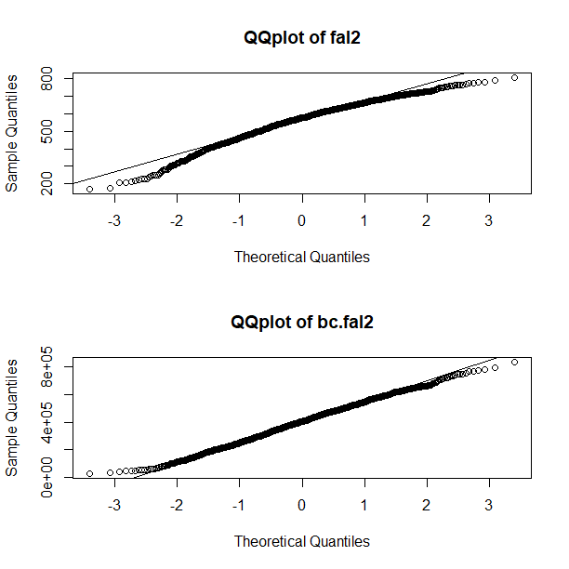
Gaussianity
QQplot and Shapiro test on each dataset
Unsatisfactory results
With a Box Cox transformation results didn’t change too much (got even worse)
We postpone the problem until we will have knowledge of more efficient methods to solve it

Slide 12
What we have done so far
Analysis of the behaviour of the formants for:
Samples for each speaker
Speaker for each diphthong
For each pair of speaker and diphthong

Slide 13
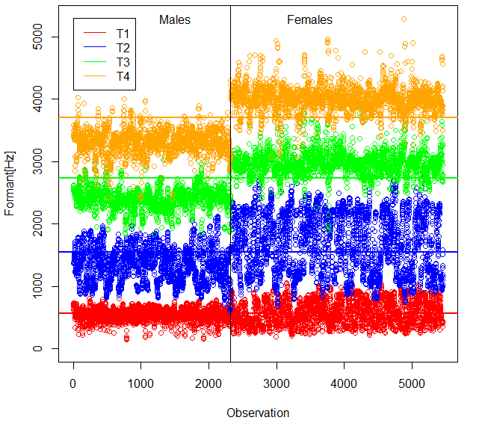
Analysis of the samples for each speaker
Third and fourth formants:
Clear distinction between the frequencies of female and male
Second formant:
Highest variability

Slide 14
Data handling
Normalization of time values
Computation of the approximated values of the formants
Usage of the approximated values for the computation of relevant features

Slide 15
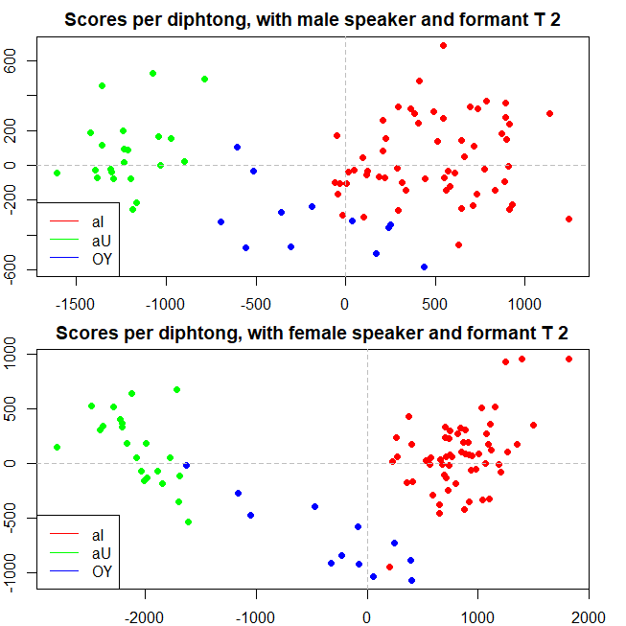
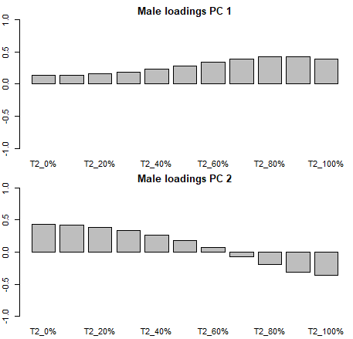
PCA on speakers
Most interesting results obtained with the second formant
Clear distinction among the diphthongs

Slide 16
Future Steps
We will analyze the classification problem of the diphthongs (with and without knowing the speaker)
Given the data time dependence, we will use the functional analysis to reach final results
If we will not find out any solution for the normality problem, we will take into account to use non parametric tests for inference

Slide 17
Thanks for your attention!
Any questions?

